Slide 1

Sales Performance Dashboard
Sharvari Kulkarni
Tool: Power BI
Dataset: Chocolate Sales

Slide 2


Objective
The objective of this project is to develop an interactive and user-friendly dashboard that transforms raw sales data into actionable business insights.
The dashboard enables stakeholders to evaluate revenue growth, profitability, product performance, and market trends through real-time KPIs and time-series analysis.
By integrating filters, dynamic visuals, and growth indicators, the dashboard supports data-driven decision-making and performance optimization.

Slide 3
Key Performance Indicators (KPIs)
Key Performance Indicators (KPIs) are measurable metrics used to evaluate how effectively a business is achieving its strategic and financial goals.
Total Sales- Represents the total revenue generated from all product transactions within the selected time period. It indicates overall business size and revenue performance.
Total Profit- Calculated as revenue minus cost (or based on assumed margin). It shows how much money the business actually retains after expenses.
Profit Margin (%)- Profit as a percentage of total sales.
Formula: Profit Margin = (Total Profit / Total Sales) × 100
It measures efficiency and pricing effectiveness. High sales with low margin can indicate pricing or cost issues.
Month-over-Month (MoM) Growth- Percentage change in sales compared to the previous month.
Formula: (Current Month Sales − Previous Month Sales) / Previous Month Sales
It shows short-term growth trends and business momentum.
Quantity Sold- Total number of product units sold during a selected period. It reflects demand level and product popularity.

Slide 4
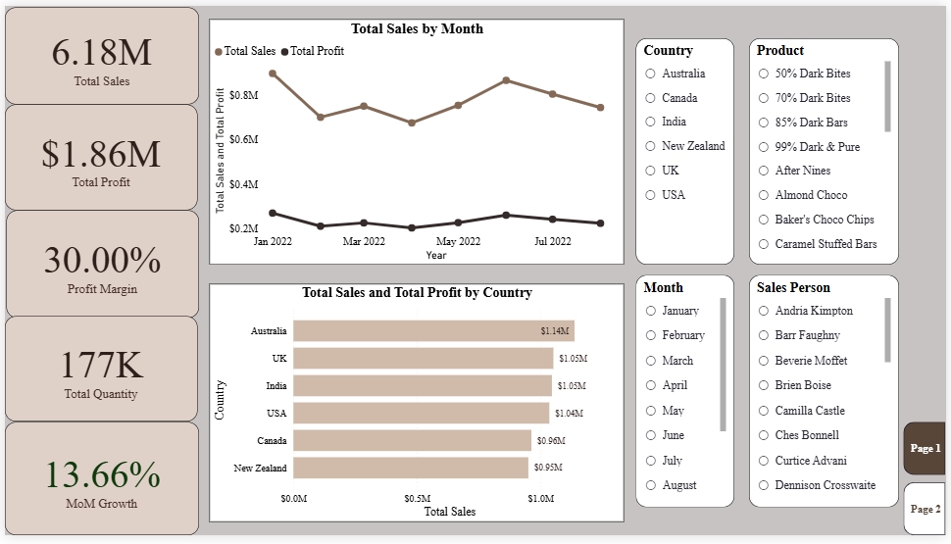
Executive Overview: Key Insights
The company generated $6.18M in total sales with $1.86M in total profit, maintaining a strong 30% profit margin, indicating healthy cost control.
Sales peaked around June–July, showing a mid-year performance spike and positive seasonal momentum.
Australia is the top-performing market ($1.14M in sales), followed closely by the UK and India (~$1.05M each), indicating strong international distribution.
Positive MoM growth of 13.66% reflects upward revenue momentum and improving performance trajectory.

Slide 5
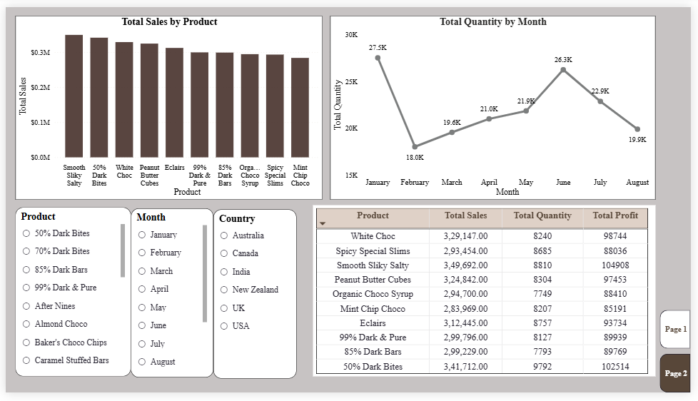
Product Performance Insights
Smooth Silky Salty and 50% Dark Bites lead revenue and profit, making them core portfolio drivers.
Quantity sold dropped sharply in February (18K) but recovered strongly by June (26.3K), indicating seasonality or campaign impact.
Some products such as White Choc and Peanut Butter Cubes generate strong sales but comparatively lower profit than top performers, suggesting room for margin optimization.
Profit contribution is concentrated in a few key products, increasing reliance risk if demand shifts.

Slide 6
Interactivity & Technical Features
Slicers (Date, Country, Product, Salesperson)
Enabled dynamic filtering across all visuals, allowing users to drill into specific markets, products, time periods, or individual sales performance instantly.
Page Navigator
Created structured navigation between Executive Overview and Product Analysis pages, improving user experience and making the report presentation-ready.
Conditional Formatting
Applied color scales on Profit Margin and growth metrics to visually highlight high-performing (green) and low-performing (red) segments for faster insight recognition.
Top N Filtering
Configured visuals to dynamically display Top 10 products based on sales, allowing focused performance analysis without clutter.
Time-Series Trend Analysis
Implemented monthly Sales and Profit trend lines to detect seasonality, growth patterns, and sudden performance shifts.

Slide 7

Strategic Actions Based on Analysis
Prioritize High-Margin Products
Increase marketing investment and promotional visibility for products delivering strong profit margins to maximize return on marketing spend.
Reevaluate Pricing of High-Volume, Low-Margin Products
Conduct cost and pricing analysis for products generating strong sales but relatively lower margins. Even small pricing adjustments could significantly improve overall profitability.
Strengthen Presence in Top-Performing Countries
Expand distribution, partnerships, and campaigns in markets like Australia, UK, and India where sales performance is already strong.
Address Seasonal Fluctuations
Investigate the February dip and replicate strategies that drove the June sales peak to stabilize revenue throughout the year.
Optimize Product Portfolio Strategy
Reduce overdependence on a few key revenue drivers by nurturing mid-tier products with strong growth potential.

